Slide 1

Mini project on -desktop Virtual assistant
By – raman daksh & Ankit tiwari

Slide 2


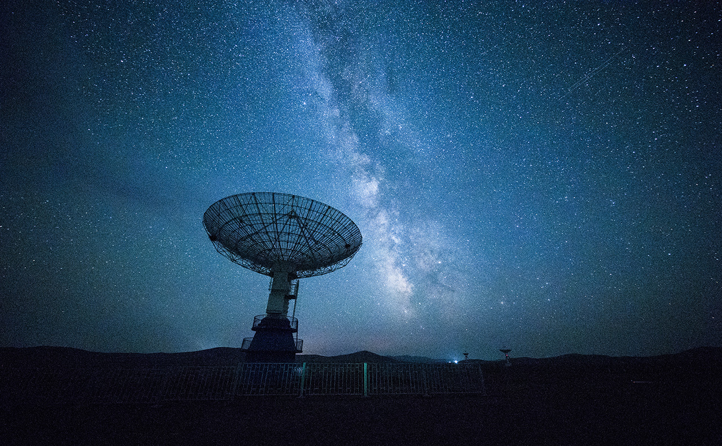
Introduction
Virtual Assistants are computer programs that provide assistance to users in completing tasks. They can be used for a variety of tasks, such as scheduling appointments, searching for information, providing reminders, and more.

Slide 3
Objectives
To develop a virtual assistant
To provide an efficient and personalized user experience
To improve productivity and save time

Slide 4
Features
Natural language processing and machine learning
Voice and text-based interactions
Integration with various apps and platforms
Customizable preferences and settings

Slide 5
Modules
pyttsx3: It is a text-to-speech conversion library in Python.
Speech_recognition as sr: Library for performing speech recognition, with support for several engines and APIs. We use Google speech recognition here.
Datetime: This is ibuild library in python for recognizing date and time.
Wikipedia: It is a python library that makes it easy to access and parse data from Wikipedia.
webbrowser: It provides high level interface to allow display web based documents to users.
Os: It provides functions for interacting with the operating system.
Smtplib: It is used to send mail to any internet machine with an SMTP or ESMTP listener daemon.
Pyaudio: It is inbuild library in python for recognizing voices of user.

Slide 6
Benefits
24/7 availability and accessibility
Increased efficiency and productivity
Enhanced user experience
Cost-effective solution

Slide 7
Target Audience
Business professionals
Students
Elderly individuals
Individuals with disabilities

Slide 8
Technology Stack
Programming languages: Python
Framework: Wikipedia API

Slide 9

Thank You

